Slide 1
Math 210 – Communicating in Math

Slide 2
Group Norms
We will…
Validate each others efforts and contributions
Be patient and listen (really listen) to everyone’s ideas
Say your ideas even if you’re not sure it’s right. Participate!
Be open minded to other people’s ideas.
Not be bossy.
Dr. Keough will…
Be open to suggestions
Not move on too quickly if people don’t understand
Offer guidance but not give things away

Slide 3
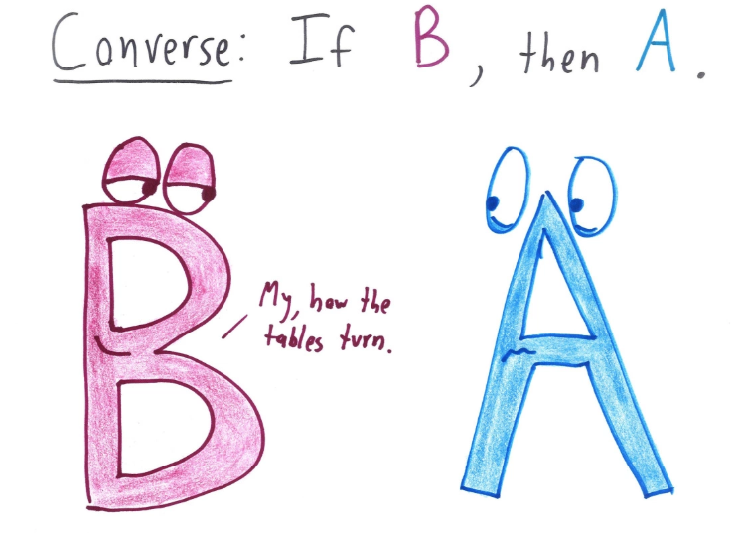
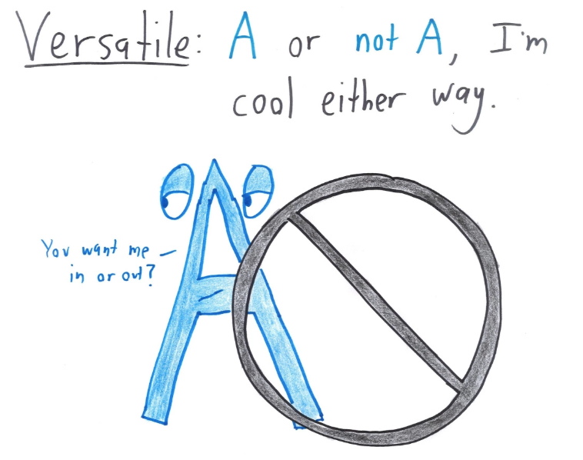
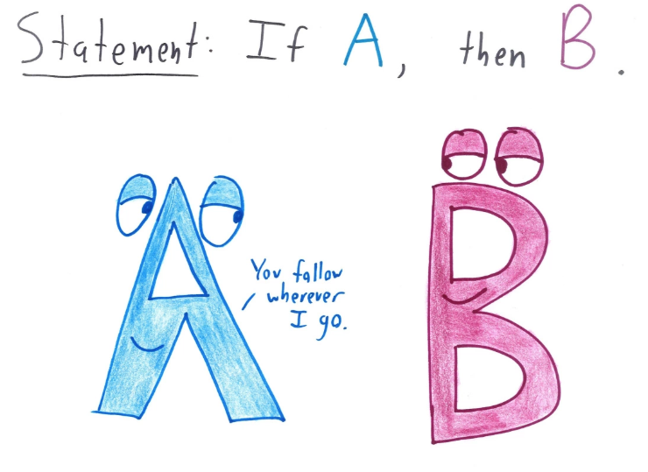
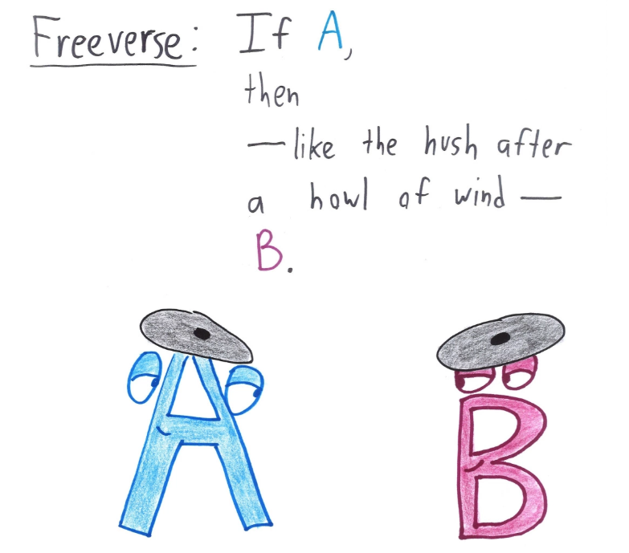
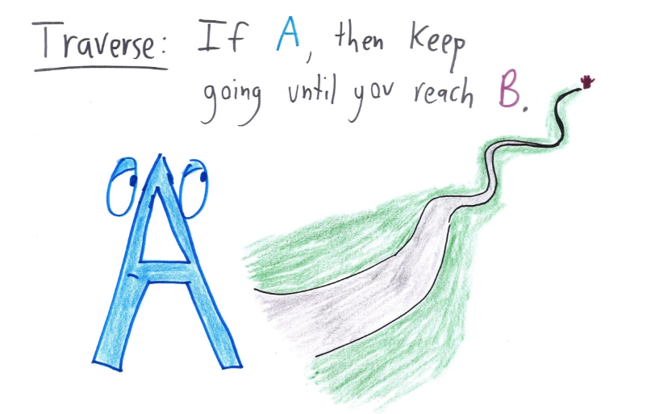

Slide 4
